Slide 1
CS 447 Recitation 8

Slide 2
Announcements
Project 2 is out!
You need to have a planning meeting with me by Tuesday the 9th
Don’t throw away 10 easy points!

Slide 3
Last Week’s Quiz
Q1:
A: The last two options.
If the result is negative, there are 1s in HI, and MSB of LO is 0 -> overflow
Q2:
A: div followed by mflo
div is a pseudo-op. It expands into the above two instructions so that the quotient can easily be placed into the target register
Notes:
Q1: Detect which of the following scenarios below have resulted in 32-bit signed multiplication overflow. Examine the values in the HI and LO registers (Select all that apply)
Q2: What operation does the div instruction actually perform?

Slide 4
Last Week’s Quiz
Q3
A: In MIPS, the values of the HI & LO registers are changed when we call either mult or mul AND Multiplication is much faster than Division because its operations could be broken down and run in parallel
The MIPS ISA will change the values of HI and LO when a multiplication is preformed, regardless of whether mult or mul was called. Multiplication can be parallelized to run in O(log(N)) time, whereas division cannot be parallelized and runs in O(N) time
Q4:
A: HI
MIPS places the remainder in HI and the quotient in LO
Notes:
Q3: Which of the following statements are true?
Q4: When dividing in MIPS, where can you find the remainder?

Slide 5
This Week’s Quiz
5 minutes to work on the quiz as per usual

Slide 6
Transistors
A transistor is like a little valve that electricity flows through
We will focus on MOSFET transistors
They come in two varieties – N and P
N type – Electricity will flow through when the input is 1
P type – Electricity will flow through when the input is 0

Slide 7
Gates
We can combine transistors to make gates
Then we can combine a load of gates to make a computer
A gate implements one of the basic boolean logic functions (NOT, OR, AND, etc)

Slide 8
Not Gate
This is the simplest gate
It simply inverts the input
We can create a NOT gate by combining an N and a P type MOSFET transistor
A
Q
A | Q
0 | 1
1 | 0

Slide 9
NAND, AND, OR, NOR
We can also create these gates using MOSFETs
You’re probably familiar with how the boolean truth tables would work for each of these
The truth table is identical when thinking about the logic gates
A
A
A
A
Q
Q
Q
Q
B
B
B
B
NAND
AND
OR
NOR

Slide 10
New Logic Gate Just Dropped
You’re might not be familiar with this one – it’s an XOR gate
That stands for eXclusive or
It means that one of the inputs must be 1, but not both
A
Q
B
XOR gate
A | B | Q
0 | 0 | 0
0 | 1 | 1
1 | 0 | 1
1 | 1 | 0

Slide 11
Combining Logic Gates
If we want to simulate more complex expressions, we just connect logic gates together
For example: (A and B) OR (not C)
Create an AND gate for A and B
A
B

Slide 12
Combining Logic Gates
If we want to simulate more complex expressions, we just connect logic gates together
For example: (A and B) OR (not C)
Create a NOT gate for not C:
C

Slide 13
Combining Logic Gates
If we want to simulate more complex expressions, we just connect logic gates together
For example: (A and B) OR (not C)
Connect them with an OR gate
A
B
AB
Q
~C
C

Slide 14
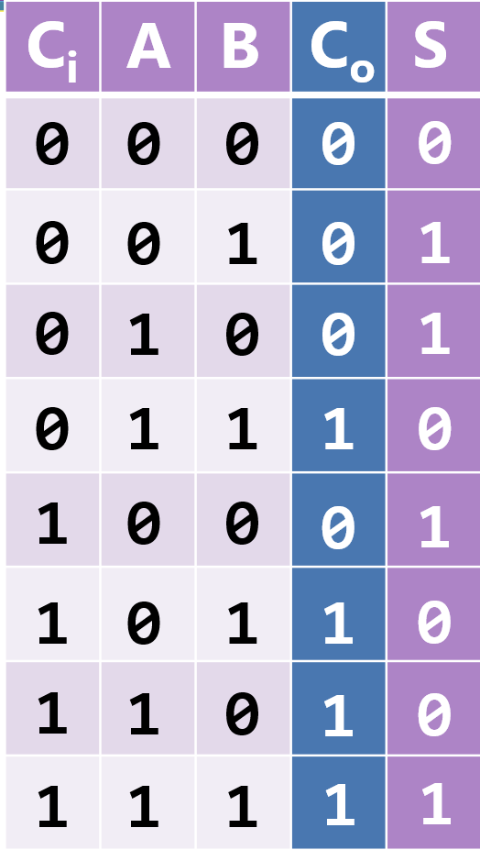
Adding Circuits
We want to create a circuit that can add numbers
3 steps:
Create a truth table that represents adding
Turn that table into a logic function
Turn that logic function into a circuit
$$C_{out}=\overline{A}BC_{in}+A\overline{B}C_{in}+AB\overline{C_{in}}+ABC_{in}$$

Slide 15
Adding Longer Numbers
We might get a carry out when adding bits in a given place
That becomes the carry in for the next place to the left
So to add n-bit numbers, we connect n one bit adders by hooking up their carry-out outputs and carry-in inputs
However – gate delay
Each bit must wait for the smaller bit to compute its carry-out value
So we get a delay that is linear in the number of bits
There are more efficient ways of adding

Slide 16
Subtracting
There is no need for a separate subtraction circuit – just add a negative
How? Flip the bits and add one
We can flip the bits using NOT gates
We can add one by setting the carry-in to 1 when subtracting

Slide 17
Detecting Overflow
For unsigned addition
Look at the carry-out of the MSB – if it’s 1, there is overflow
For signed addition
Look at the last carry-in and carry-out – if they are different, there is overflow

Slide 18
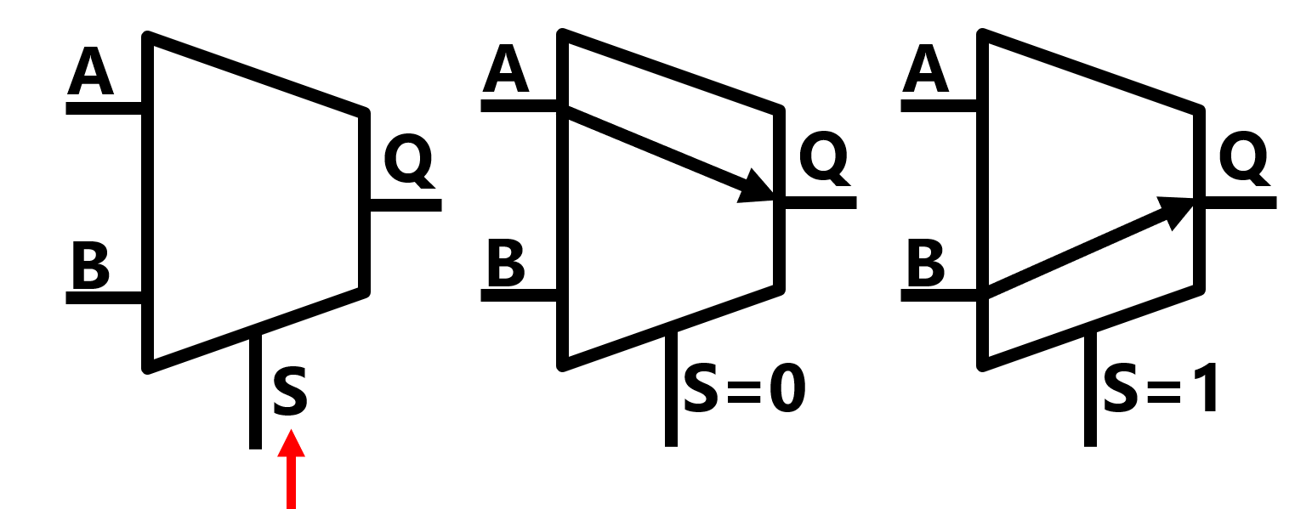
Multiplexers
We want to our hardware to make decisions
A multiplexer (mux) outputs one of its inputs based on a select
Notes:
Multiple inputs, one output

Slide 19
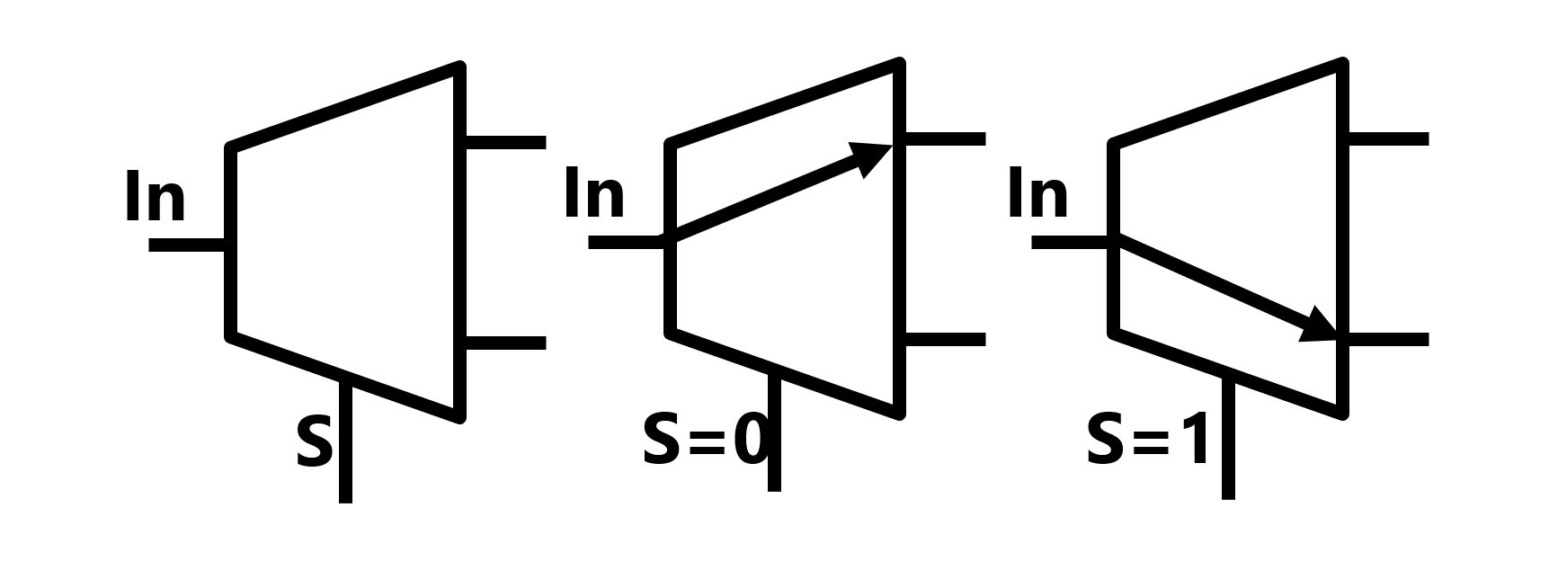
Demultiplexers
A demultiplexer (demux) does the opposite of a mux
It sends its input to one of its outputs
Notes:
One input, multiple outputs

Slide 20
Encoders
An encode turns 2^{n} inputs into n outputs
That is, you give it a bunch of 1-bit inputs, and it’ll tell you which one is 1
Note: exactly one input must be 1, otherwise the output is invalid
1
0
Enc
0
Enc
Enc
0
0
0
0
1
0
1
1
0
1
0
1
0
???
0
0
2
0
0
2
1
0
0
2
1
???
1
0
0
3
0
valid
0
3
3

Slide 21
Priority Encoders
We can fix that issue using priority encoders
These will tell you which of the inputs is the highest with a 1
So you can have multiple inputs be 1
All 0s is still invalid, however
0
Pri
1
Pri
0
X
0
0
0
0
1
0
1
0
X
1
1
0
2
0
1
2
1
valid
0
3
0
3

Slide 22
Decoder
A decoder is the opposite of an encoder
It has multiple outputs
The output corresponding to the value of the select input is a 1, and all others are 0
Example: the select input is 0, so the 0’th output is 1

Slide 23
Project 2
This project is a game!
It’s basically the game Millipede that you might’ve seen in an arcade
Gameplay overview:
A millipede starts at the top of the screen and crawls towards the bottom
There are mushrooms on the screen that block the millipede’s path
The player shoots at the millipede
If a section is destroyed, it turns into a mushroom

Slide 24
The Arena
The display in MARS is 64 by 64 pixels
It should be divided into two parts – The upper section where gameplay happens and the lower section where information is displayed
Bottom part
Designate some section of the 64x64 grid as the “bottom part”
You should have some variables to store the number of points and lives
Use the provided functions to display these values
Top part
The other part of the grid is the top part
Mushrooms, millipede segments, and the player are all 5x5 squares
You need to know whether a given coordinate has a mushroom – maybe use a matrix?

Slide 25
Displaying Things
The mushrooms, millipede segments, and player are all 5x5 pixels
The project description refers to things of this size as “blits”
They are represented as 5x5 matrices of bytes
Use the display_blit_5x5 to draw the millipedes and mushrooms
Use display_blit_5x5_trans to draw the player
There are also built in functions to draw lines, numbers, and text
Use the functions provided to you!

Slide 26
The Player
The player can be moved with the arrow keys, and can shoot with the ‘b’ button
Make sure you check for collisions with the arena bounds so the player can’t move offscreen
Remember MVC: what do you need to keep track of for the player?
X coordinate, y coordinate, points, lives, appearance, etc
Follow the hints/steps given in the project description
Write small bits of code at a time and test
Notes:
Same idea as in Lab 7!

Slide 27
The Millipedes
When the game starts, there should be a millipede consisting of at least 5 segments
It will move horizontally until it either hits an edge or a mushroom, in which case it moves downwards one row
You can ignore mushrooms when moving down
If the millipede gets shot
The segment that was shot turns into a mushroom
The millipede splits in two
If the millipede hits the bottom
The player loses a life
The millipede despawns and reappears at the top

Slide 28
Representing the Millipedes
You’ll need some way to represent the millipedes in memory
I would use an array of structs (Lab 7!) but you don’t have to
Think about what information on each segment needs to be stored
Position, whether it’s a head, etc
Follow along with the implementation hints in the project description

Slide 29
The Bullet
When the player shoots:
A bullet appears in the same block as the player
It moves upwards until it hits something or reaches the top of the screen
If it hits a mushroom: Remove the mushroom
If it his the millipede: That segment is destroyed; millipede splits
After the bullet either hits something or reaches the top, it should despawn

Slide 30
Starting and Ending the Game
When the game starts, wait for the player to press a key
Check out the input_get_keys_pressed function
The game ends when the player runs out of lives
Once the game is over, display the player’s score

Slide 31
General Tips
Write small pieces and then test
Split your code up
Divide your program into multiple files – when I did this project the model, view, and controller for each element were their own files
Divide files into functions
Each function should do a single thing
Split big functions into smaller functions!
Use the model-view-controller paradigm
Plan out code before you write it
The project description has a ton of hints – follow them. You should also follow along with the suggested project stages

Slide 32
Lab 8 Part A
Make sure you have Logisim downloaded and that it works
If you’re having trouble, talk to me
This part of the lab will introduce you to the Logisim software
You’re given the circuit diagram for a one-bit adder. All you need to do is follow along with the directions and implement it

Slide 33
Lab 8 Part B
You’re given a truth table and a boolean expression that you need to turn into a circuit
What you submit does not need to be optimal as long as it works correctly
It still wouldn’t hurt to think of ways you might shrink the circuit
We talked about combining gates to form more complex circuits – that’s what you need to do here

Slide 34
Lab 8 Part C
You have the adder circuit from part A
Change the input pins and fill out the table based on what you see
All you need to do is try all the different values for A, B, and C_in and see what the value of each gate is

